Slide 1
Network Intrusion Detection
AICTE PROJECT
Presented By:
Student Name- Karan
College Name-Department - Haryana Engineering College (CSE)

Slide 2
OUTLINE
Problem Statement
Proposed System/Solution
System Development Approach
Algorithm & Deployment
Result (Output Image)
Conclusion
Future Scope
References

Slide 3
Problem Statement
Example: Create a robust network intrusion detection system (NIDS) using machine learning. The system should be capable of analyzing network traffic data to identify and classify various types of cyber-attacks (e.g., DoS, Probe, R2L, U2R) and distinguish them from normal network activity. The goal is to build a model that can effectively secure communication networks by providing an early warning of malicious activities.

Slide 4
Proposed Solution
The proposed system aims to automate the detection and classification of power system faults using machine learning models built with IBM Watsonx AutoAI. The goal is to identify and classify various types of cyber-attacks (e.g., DoS, Probe, R2L, U2R) and The goal is to build a model that can effectively secure communication networks by providing an early warning of malicious activities.
The solution consists of the following components:
1. Data Collection:
Use a public dataset containing various types of cyber-attacks (e.g., DoS, Probe, R2L, U2R) .
The dataset includes labeled class, aiding supervised learning.
2. Data Preprocessing:
Upload the dataset to IBM Cloud Object Storage.
Configure columns and handle missing values directly in Watsonx AutoAI.
3. Model Building using AutoAI:
AutoAI automatically explores and trains multiple ML pipelines.
Selects the best-performing classifier (e.g., Random Forest, Logistic Regression, XGBoost).
Evaluates models based on accuracy, precision, and recall.

Slide 5
Proposed Solution
4. Deployment:
The best model is promoted to a Deployment Space.
A REST API is created to receive network data as input and return anamoly classification.
5. Testing & Evaluation:
Use test JSON inputs to validate model performance.
Observe model outputs in both table and JSON format.
Analyze AutoAI pipeline leaderboard to choose optimal model

Slide 6
System Approach
The "System Approach" section outlines the overall strategy and methodology for developing and deploying a machine learning-based analyzing network traffic data to identify and classify various types of cyber-attacks (e.g., DoS, Probe, R2L, U2R) and distinguish them from normal network activity model using IBM Watsonx AutoAI
1. System Requirements:
IBM Cloud Lite Account
IBM Watsonx.ai Studio
IBM Cloud Object Storage
Modern Web Browser (Chrome/Firefox)
Stable Internet Connection
Kaggle Dataset: Network Intrusion
2. Libraries / Services Used:
IBM Watsonx AutoAI (no manual coding required)
IBM Watson Machine Learning Runtime
IBM Cloud Object Storage
JSON for testing API input/output
3. Development Methodology:
Create Watsonx.ai instance and associate storage
Upload dataset (network intrusion dataset) to the project
Define and configure an AutoAI experiment
AutoAI automatically selects and trains ML pipelines
Evaluate model performance via leaderboard
Save and deploy the best-performing pipeline
Generate and test API endpoint using JSON input
This system-oriented approach ensures a no-code, rapid ML solution using cloud-native IBM tools, making it suitable for scalable, real-time grid fault analysis.

Slide 7
Algorithm & Deployment
This section describes the machine learning algorithm selection, training process, and deployment strategy used to detect and classify network intrusion with IBM Watsonx AutoAI.
Algorithm Selection:
IBM Watsonx AutoAI automatically explores multiple classification algorithms, such as:
Logistic Regression
Decision Trees
Random Forest
Gradient Boosted Trees (XGBoost)
Ensemble Models
The final model is selected based on evaluation metrics like accuracy, precision, and recall. AutoAI uses automated hyperparameter tuning and pipeline optimization to determine the best-performing algorithm for the classification task.
Data Input:
Protocol type , service ,flag and class (A, B, and C D)
Output Label: class(e.g., Normal, Anomaly)
AutoAI automatically detects feature types and handles preprocessing like scaling, encoding, and missing values internally.

Slide 8
Algorithm & Deployment
Training Process:
AutoAI splits the dataset into training and validation sets.
Applies automated feature transformation, model selection, and optimization.
Evaluates multiple pipelines using cross-validation.
Ranks them on a leaderboard based on performance metrics.
Prediction Process:
The best model pipeline is saved and promoted to the deployment space.
It is exposed as a REST API that accepts JSON input (voltage/current values).
The model processes the input and returns the predicted fault type in real-time.
This pipeline ensures reliable and scalable fault classification without requiring manual coding, making it suitable for integration in real-world power monitoring systems.

Slide 9
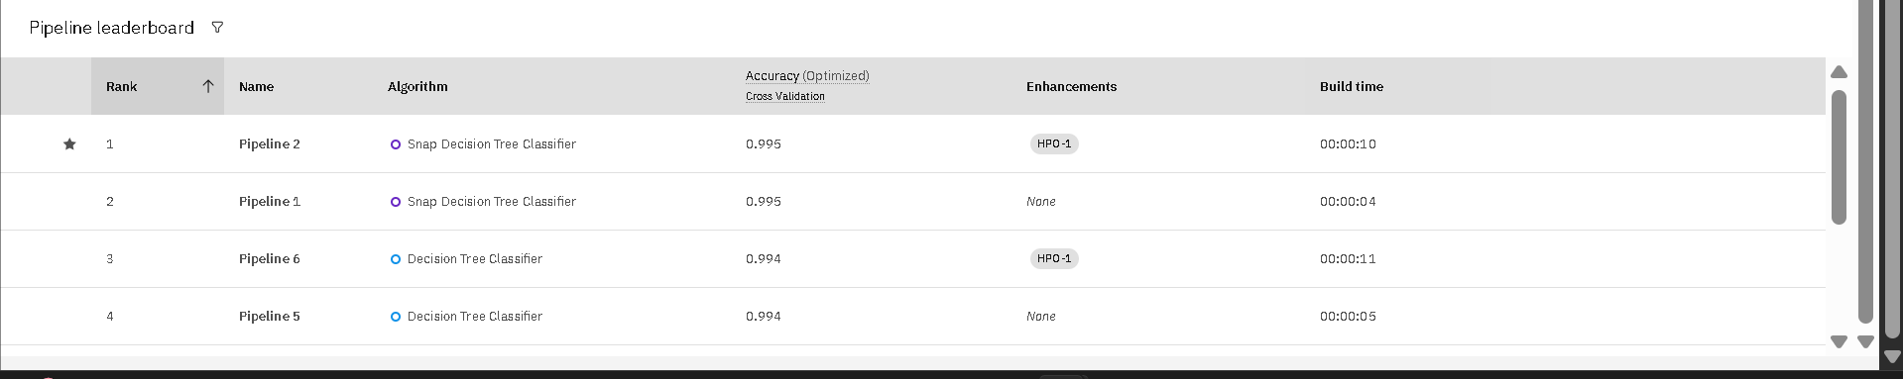
Result
The machine learning model generated by IBM Watsonx AutoAI demonstrated high accuracy in detecting and classifying various fault types in the power distribution system.
Key Performance Metrics:
Accuracy: [Insert actual % from leaderboard]
Precision: High precision in identifying LG, LL, and LLG faults
Recall: Strong recall values for multiclass classification
F1 Score: Balanced performance across fault types

Slide 10
Result
Pipeline Leaderboard:
AutoAI ranked multiple pipelines based on their validation scores
The top pipeline was selected and saved for deployment

Slide 11
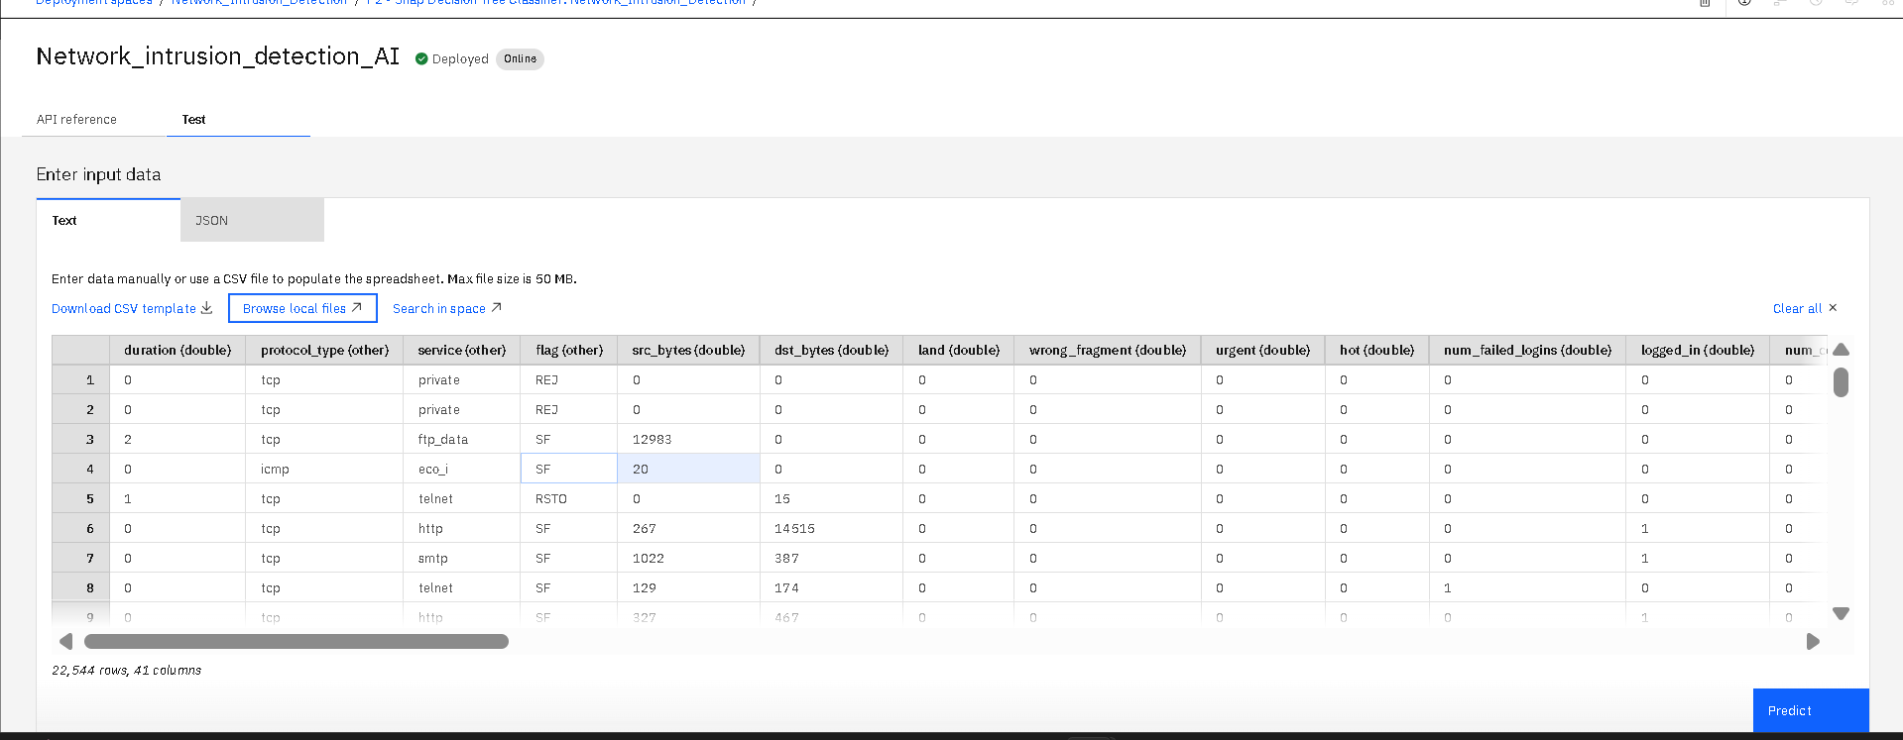
Result
Model Output Formats:
Output Table View: Displays predicted anomaly class against test data

Slide 12
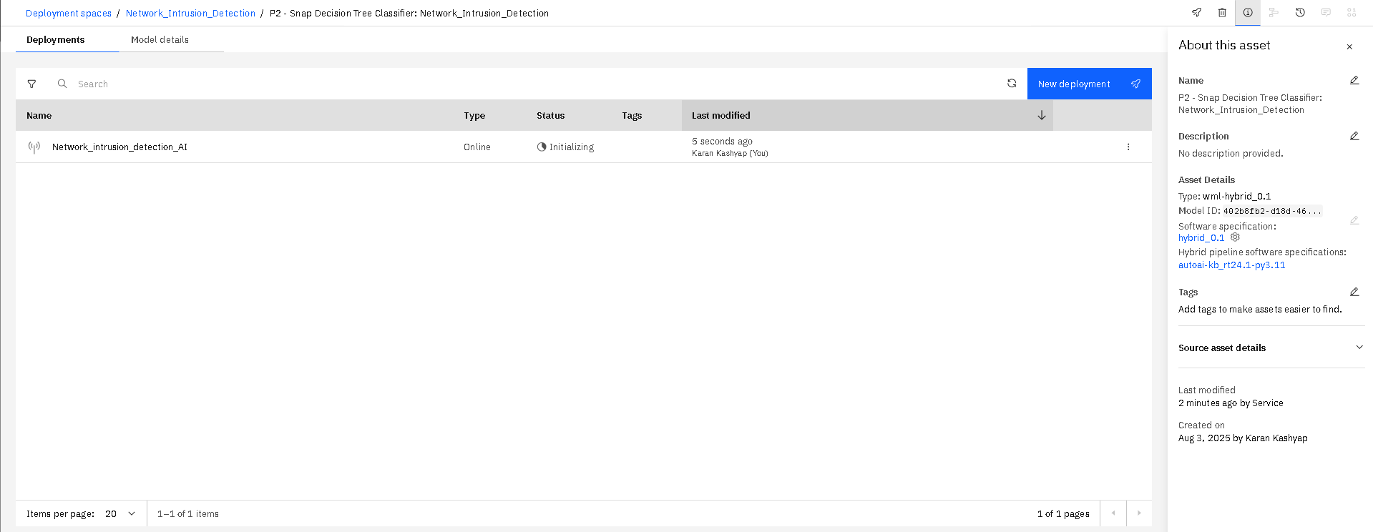
Result
Model Output Formats:
JSON Output View: Shows prediction results in API-compatible JSON format

Slide 13
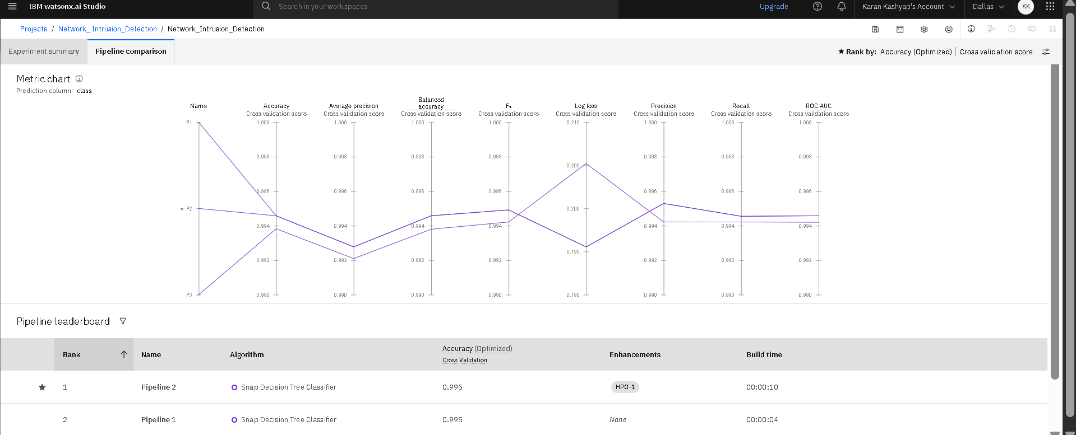
Result
Visuals to Include (Screenshots):
1. Progress Map
– AutoAI's visual representation of pipeline evolution

Slide 14
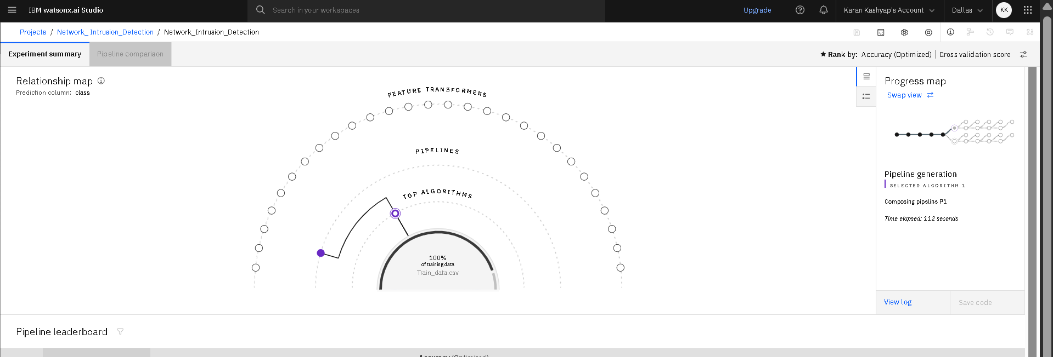
Result
2. Relationship Map
– How input features influence predictions
The model’s deployment as an API allows real-time classification of hacking attacks.

Slide 15
Conclusion
The developed Network Intrusion Detection System (NIDS) using AutoAI in IBM Watson Studio successfully automates the process of detecting malicious network activities. By leveraging machine learning algorithms automatically selected and optimized by AutoAI, the model is able to:
Efficiently classify network traffic as normal or anomalous.
Reduce the manual effort of feature engineering and model selection, thanks to AutoAI’s automated pipeline generation.
Provide real-time or near real-time predictions, enhancing cybersecurity measures in dynamic network environments.
Achieve high accuracy and reliability while minimizing false alarms compared to traditional rule-based intrusion detection systems.
This demonstrates the potential of AI-driven intrusion detection in strengthening network security infrastructure against evolving cyber threats.

Slide 16
Future scope
Enhancing Data Quality and Balance:
Introduce more diverse datasets covering latest cyberattack types.
Use data balancing techniques (SMOTE, class weights) to improve anomaly detection accuracy.
Feature Engineering Improvements:
Perform manual domain-based feature selection alongside AutoAI’s automated approach to reduce noise.
Explore advanced feature extraction techniques (e.g., embeddings for categorical features).
Model Explainability:
Use SHAP or LIME to interpret how the model classifies anomalies, increasing trust and transparency.
Real-Time Deployment:
Integrate with live network monitoring systems to enable streaming intrusion detection.
Deploy as a cloud-based API for scalable use across multiple networks.
Hybrid and Ensemble Approaches:
Combine AutoAI’s supervised model with unsupervised anomaly detection techniques (Autoencoders, Isolation Forest) for unknown attack patterns.
Continuous Learning:
Implement online learning or periodic retraining so the model adapts to new cyber threats without manual intervention.
Integration with Security Tools:
Connect with firewalls, SIEM tools (e.g., Splunk, QRadar) for automatic threat response and mitigation.
;

Slide 17
References
1. Kaggle Dataset:
“Network intrusion detection.”
https://www.kaggle.com/datasets/sampadab17/network-intrusion-detection
2. IBM Cloud Documentation:
IBM Watsonx.ai and AutoAI Official Guide
https://www.ibm.com/cloud/watsonx
3. 4. 5. AutoAI Model Evaluation Guide:
“Model Evaluation Metrics in IBM AutoAI” – IBM Developer Documentation
https://cloud.ibm.com/docs/autoai?topic=autoai-evaluation

Slide 18
References
6. JSON Format Testing for ML APIs:
IBM Watson Machine Learning API Reference
https://cloud.ibm.com/apidocs/machine-learning
7. Book Reference (optional):
James, G., Witten, D., Hastie, T., & Tibshirani, R. (2013).
*An Introduction to Statistical Learning: With Applications in R*. Springer.

Slide 19
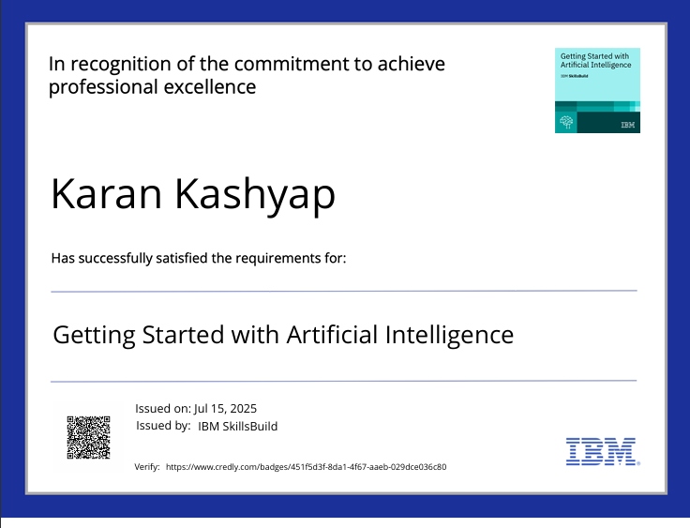
IBM Certifications
Screenshot/ credly certificate( getting started with AI)

Slide 20
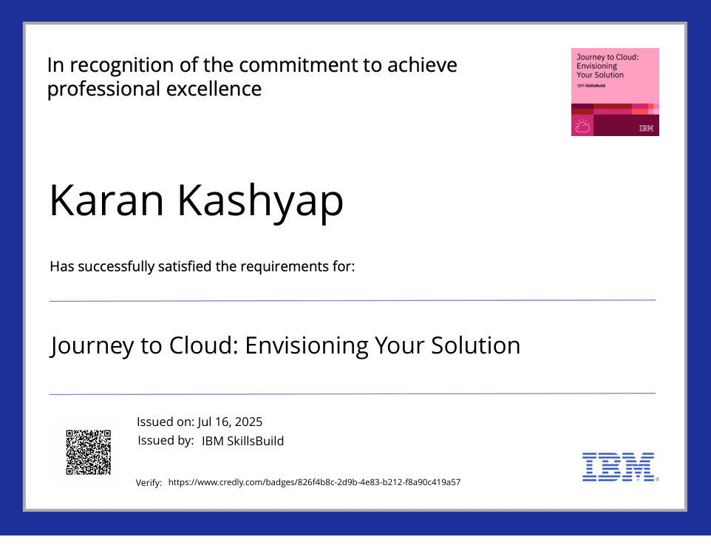
IBM Certifications
Screenshot/ credly certificate( Journey to Cloud)

Slide 21
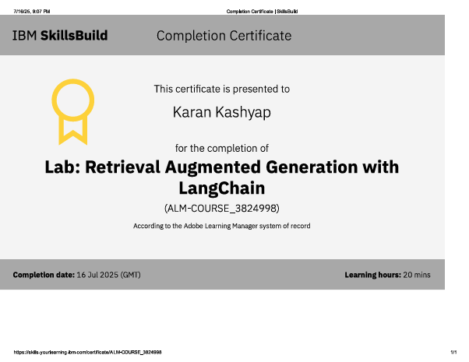
IBM Certifications
Screenshot/ credly certificate( RAG Lab)

Slide 22
GitHub
GitHub Linkt:-
https://github.com/opmk1234/Network-Intrusion-Detection.git

Slide 23
THANK YOU

